Slide 1

RBNA DATA SCIENCE

Slide 2
DS Data ENGINEERING @ RED BULL
CASE STUDY 1
Case Study Overview
This case study is designed to test your data engineering and analytical skills. The task outlined here is indicative of the challenges typical of some of the work that the Analytics team might perform for the business.
You will be given this case study pack approximately one week before your technical & business assessment. This reflects the fact that we are not looking for an exhaustive analysis and are more interested in seeing how you approach the problem and communicate your results. (we really mean it - you can put placeholders in your presentation and explain verbally what you would do with more time)
There is no “right answer” that you will be assessed against although we will expect you to be able to justify any conclusions from an analytical and/or technical standpoint so be prepared to be questioned on your approach. Last, our team of analytics professionals primarily use Python, R, SQL, and currently have AWS Redshift, Tableau, Power BI available to them. BUT you can use the language and tools of your choice to complete the case.
Assessment
The assessment will involve a more technical assessment of your approach and results and a separate “business presentation” of your findings back to a senior stakeholder. Each of the business and technical presentations should be ~15 mins. Again, we really mean it when we say you can use placeholders in your presentation. We love that you have a life and don’t want you to spend too much time on this task.
As part of this assessment we want to see your analytical skill, creativity and ability! We will primarily be judging you by your ability to do the following:
Effectively capture, structure, and present data to a technical and non-technical audience
Demonstrate proficiency in data architecture, modeling, and how you’d build a data pipeline
Communicate data structure and definition to analysts and data scientists
Frame vaguer business questions into more concrete analytical/data questions
Identify any potential KPIs, insights/trends and provide innovative ways to visualizing/look at the data

Slide 3
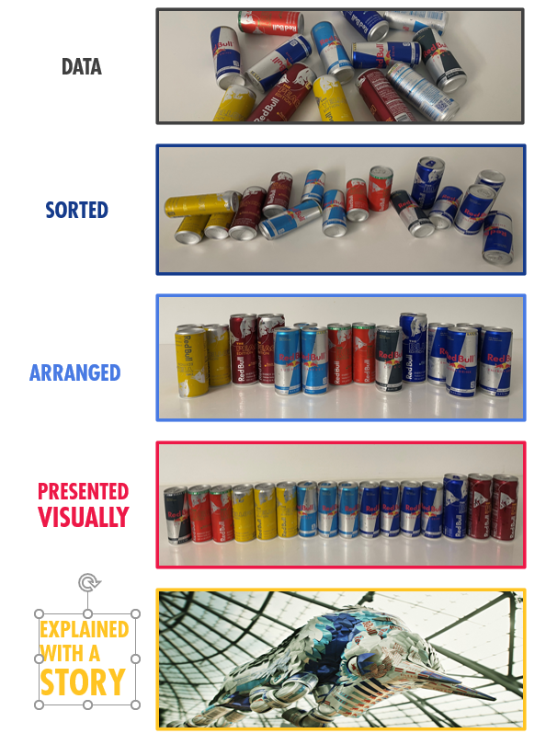
Data ENGINEERING CASE STUDY
Project Brief
We’ve provided some F1 data to use for your case. Please assess the data and prepare for use by data scientists, analytics professionals and business analysts.
If you want to get fancy, you can combine it with another data source of your choice (scraped, downloaded, etc.) and show the pipeline and structure that you’d build for use in analytics and web/app endpoints. Would be cool to understand how you’d document your work (data dictionary, visuals, etc).
For the business presentation, please complete a descriptive analysis and highlight any notable insights that would be helpful for an analyst or data scientist that would be using the data.
We really can’t stress enough how much we love and respect that you have a life. Please take us seriously when we say placeholders with an explanation of what you’d do with enough time. We’re more interested in how you approach your work and think through it than you delivering a production product.
EXPLAINED
WITH A
STORY

